Slide 1
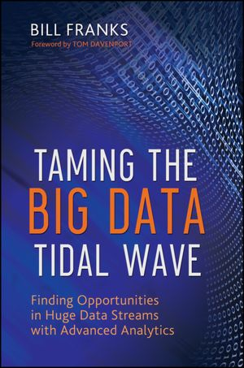
Introduction to Big Data
Taming The Big Data Tidal Wave
SNU IDB Lab.
Big Data Team

Slide 2
Outline
What is Big Data and Why Does It Matter?
What Is Big Data?
How Is Big Data Different and More of the Same?
Risks of Big Data
The Structure of Big Data
Most Big Data Doesn’t Matter
Mixing Big Data with Traditional Data
Today’s Big Data Is Not Tomorrow’s Big Data
Web Data: The Original Big Data
Web Data Overview
What Web Data Reveals
Web Data in Action

Slide 3
What Is Big Data?
There is not a consensus as to how to define big data
“Big data exceeds the reach of commonly used hardware environments and software tools to capture, manage, and process it with in a tolerable elapsed time for its user population.” - Teradata Magazine article, 2011
“Big data refers to data sets whose size is beyond the ability of typical database software tools to capture, store, manage and analyze.” - The McKinsey Global Institute, 2011

Slide 4
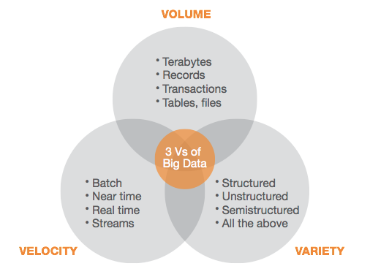
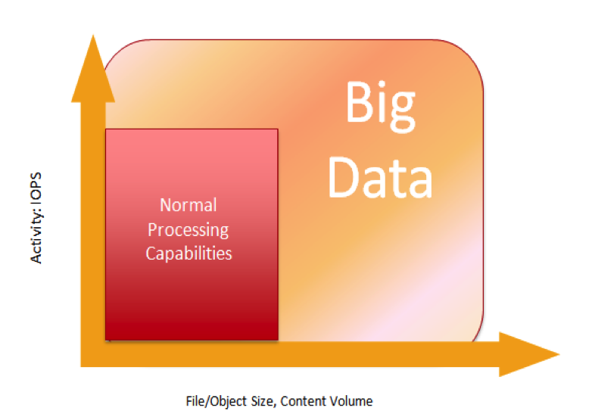
What Is Big Data?
The “BIG” in big data isn’t just about volume
* IOPS(Input/Output Operations Per Second)

Slide 5
Is the “Big” Part or the “Data” Part More Important?
The “big” part
The “data” part
Both
Neither
The answer is choice (4)
What organizations do with big data

Slide 6
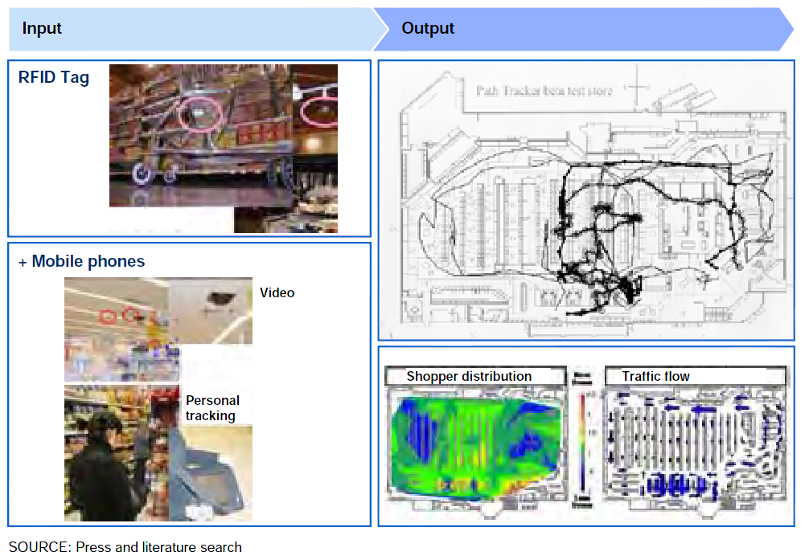
Big Data Analysis Example: Product arrangement
How does location tracking work?
Recognize the dead zone

Slide 7
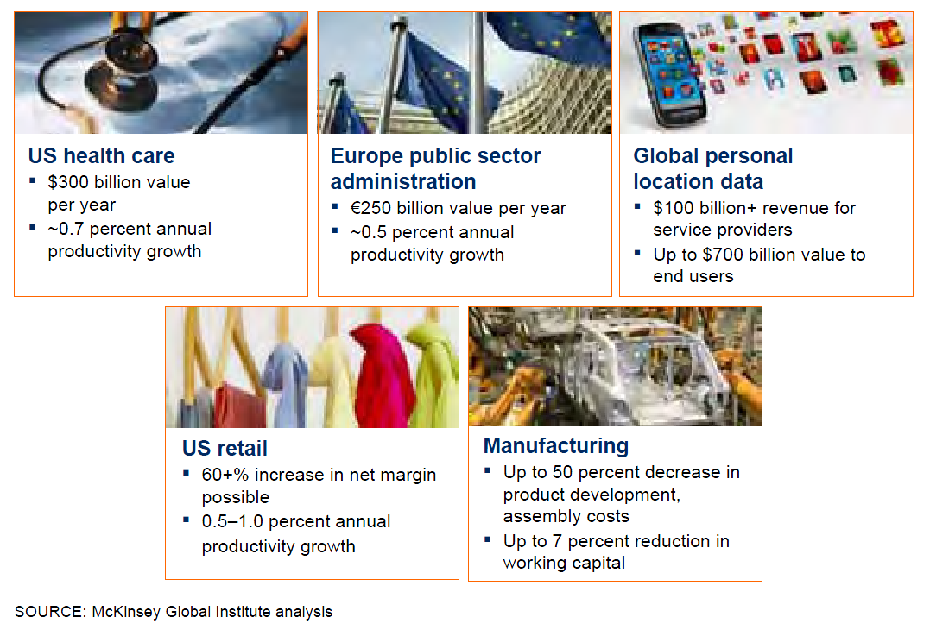
Big Data Analysis Example
Big data can generate significant financial value across sectors

Slide 8
Outline
What is Big Data and Why Does It Matter?
What Is Big Data?
How Is Big Data Different and More of the Same?
Risks of Big Data
The Structure of Big Data
Most Big Data Doesn’t Matter
Mixing Big Data with Traditional Data
Today’s Big Data Is Not Tomorrow’s Big Data
Web Data: The Original Big Data
Web Data Overview
What Web Data Reveals
Web Data in Action

Slide 9

How Is Big Data Different?
1) Automatically generated by a machine
(e.g. Sensor embedded in an engine)
2) Typically an entirely new source of data
(e.g. Use of the internet)
3) Not designed to be friendly
(e.g. Text streams)
4) May not have much values
Need to focus on the important part

Slide 10
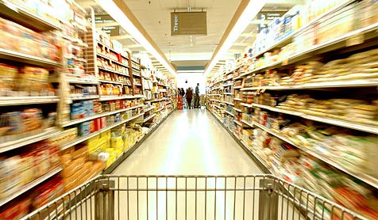


How Is Big Data More of the Same?
Most new data sources were considered big and difficult
Just the next wave of new, bigger data
< The past >
< The present >
< The future >

Slide 11
Outline
What is Big Data and Why Does It Matter?
What Is Big Data?
How Is Big Data Different and More of the Same?
Risks of Big Data
The Structure of Big Data
Most Big Data Doesn’t Matter
Mixing Big Data with Traditional Data
Today’s Big Data Is Not Tomorrow’s Big Data
Web Data: The Original Big Data
Web Data Overview
What Web Data Reveals
Web Data in Action

Slide 12
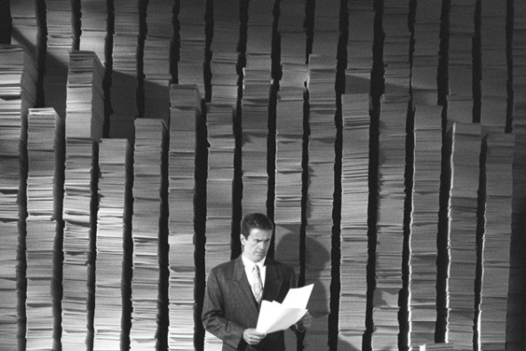
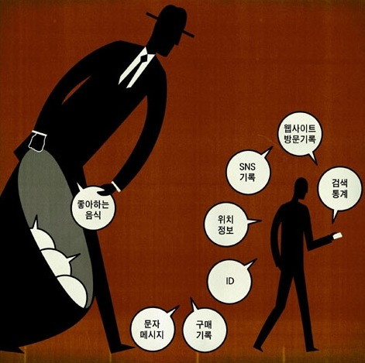
Risks of Big Data
Will be so overwhelmed
Need the right people and solve the right problems
Costs escalate too fast
Isn’t necessary to capture 100%
Many sources of big data is privacy
self-regulation
Legal regulation

Slide 13
Why You Need to Tame Big Data
Analyzing big data is already standard
(e.g. ecommerce)
Be left behind in a few years
So far, only missed the chance on the bleeding edge
Capturing data, using analysis to make decisions
Just an extension of what you are already doing today

Slide 14
Outline
What is Big Data and Why Does It Matter?
What Is Big Data?
How Is Big Data Different and More of the Same?
Risks of Big Data
The Structure of Big Data
Most Big Data Doesn’t Matter
Mixing Big Data with Traditional Data
Today’s Big Data Is Not Tomorrow’s Big Data
Web Data: The Original Big Data
Web Data Overview
What Web Data Reveals
Web Data in Action

Slide 15
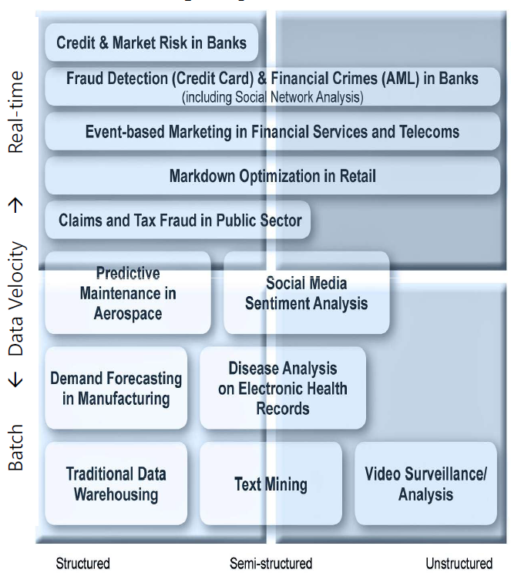
The Structure of Big Data
Structured
Most traditional data sources
Semi-structured
Many sources of big data
Unstructured
Video data, audio data

Slide 16
Exploring Big Data
The time for
developing an analysis
(Initially working with big data)
The time for
developing an analysis
Analyzing
data
(5%)
Analyzing
data
(20~30%)
Gathering & preparing
data
(70~80%)
Gathering & preparing
data
(95%)

Slide 17
Outline
What is Big Data and Why Does It Matter?
What Is Big Data?
How Is Big Data Different and More of the Same?
Risks of Big Data
The Structure of Big Data
Most Big Data Doesn’t Matter
Mixing Big Data with Traditional Data
Today’s Big Data Is Not Tomorrow’s Big Data
Web Data: The Original Big Data
Web Data Overview
What Web Data Reveals
Web Data in Action

Slide 18
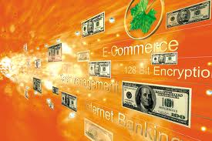
Filtering Big Data Effectively
Sipping from the hose
The extract, transform, and load (ETL) processes
taking a raw feed of data, reading it, and producing a usable set of output
Focus on the important pieces of the data
It makes big data easier to handle
Extract
Transform
Load

Slide 19


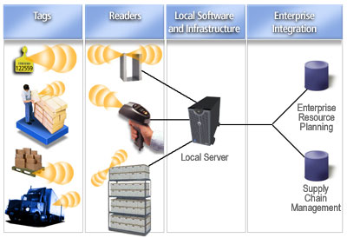
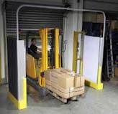
The Example of RFID Tags
Have short-term value
(e.g.) The responses at 10 second intervals between tags and readers
Have long-term value
With the entry and exit of the pallet

Slide 20
Outline
What is Big Data and Why Does It Matter?
What Is Big Data?
How Is Big Data Different and More of the Same?
Risks of Big Data
The Structure of Big Data
Most Big Data Doesn’t Matter
Mixing Big Data with Traditional Data
Today’s Big Data Is Not Tomorrow’s Big Data
Web Data: The Original Big Data
Web Data Overview
What Web Data Reveals
Web Data in Action

Slide 21
Mixing Big Data with Traditional Data
The biggest value in big data can be driven by combing big data with other corporate data
Big data
Create a synergy effect
Other data

Slide 22
Mixing Big Data with Traditional Data
Browsing history
Knowing how valuable a customer is
What they have bought in the past
Smart-grid data
For a utility company
Knowing the historical billing patterns
Dwelling type
Text (Online chat and e-mails)
Knowing the detailed product specification being discussed
The sales data related those products

Slide 23
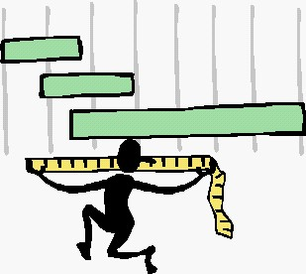

The Need for Standards
Become more structured over time
Fine-tune to be friendlier for analysis
Standardize enough to make life much easier

Slide 24
Outline
What is Big Data and Why Does It Matter?
What Is Big Data?
How Is Big Data Different and More of the Same?
Risks of Big Data
The Structure of Big Data
Most Big Data Doesn’t Matter
Mixing Big Data with Traditional Data
Today’s Big Data Is Not Tomorrow’s Big Data
Web Data: The Original Big Data
Web Data Overview
What Web Data Reveals
Web Data in Action

Slide 25
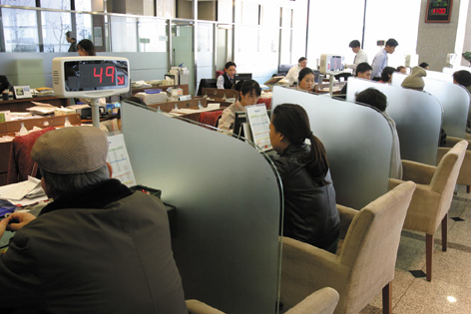
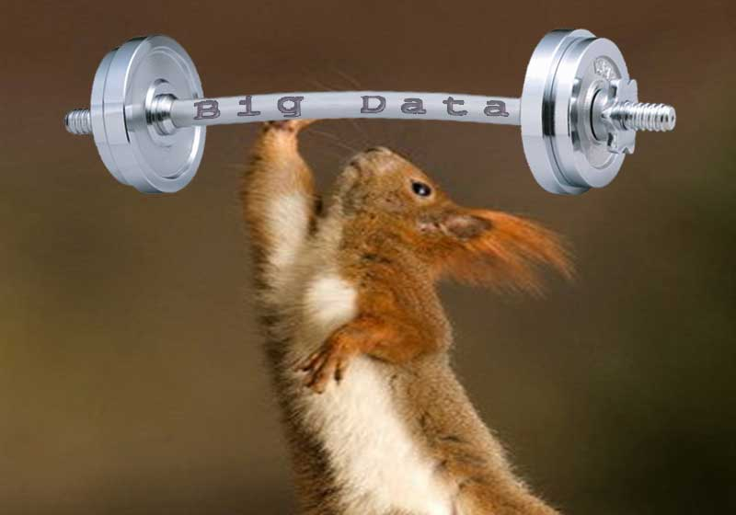
Today’s Big Data Is Not Tomorrow’s Big Data
Banking industries were very hard to handle even a decade ago
Retail
Telecommunications
“BIG” will change
Big data will continue to evolve
Another new data source will come

Slide 26
Outline
What is Big Data and Why Does It Matter?
What Is Big Data?
How Is Big Data Different and More of the Same?
Risks of Big Data
The Structure of Big Data
Most Big Data Doesn’t Matter
Mixing Big Data with Traditional Data
Today’s Big Data Is Not Tomorrow’s Big Data
Web Data: The Original Big Data
Web Data Overview
What Web Data Reveals
Web Data in Action

Slide 27
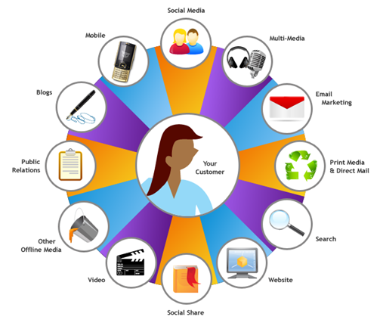
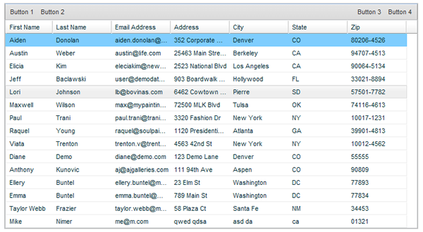
Web Data Overview (1/6) 360-Degree View
Organizations have talked about a 360-degree view of their customers
What is a 360-degree view?
Names & Addresses
Notes:
360-degree view란?
: 간단히 말해서 해당 organization과의 더 나은 interaction을 위해 그 고객의 가능한 한 모든 information을 얻는 것을 의미한다.
실제로 진정한 의미의 360-degree view을 가진다는 것은 불가능하다.
때와 장소에 따라 얻을 수 있는 정보의 종류와 양이 달라지며 필요성 또한 달라지기 때문이다.
수십 년 전에는 단순히 고객의 이름과 주소를 아는 것만으로도 모든 information을 얻었다고 생각했다.
하지만 오늘날에는 고객과 관련된 수많은 information source가 생겨나고 있고 이것들을 얻기 위한 추가적인 노력이 필요하게 되었다.

Slide 28

Web Data Overview (2/6) What Are You Missing?
About 2% of browsing sessions complete a purchase
Information is missing on more than 98% of web sessions
If only transactions are tracked
98% of Information
Notes:
단순한 하나의 web session을 하나의 transaction으로 생각했을 때

Slide 29
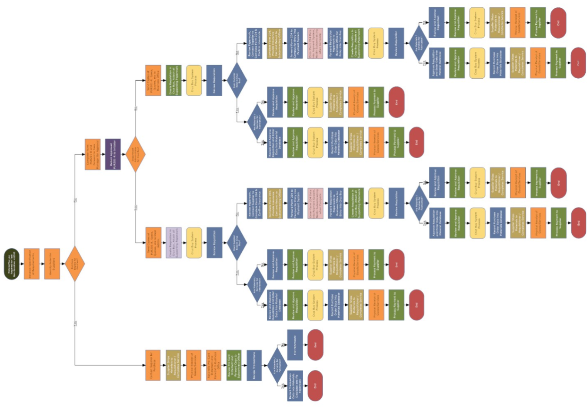
Web Data Overview (3/6) Importance of Missing Information
For every purchase transaction
There might be dozens or hundreds of specific actions
That information needs to be collected and analyzed
Action flow
Notes:
Transaction에서 구매하기로 결정했느냐 아니냐는 더 이상 무엇보다도 중시되는 가치는 아니다.
중요한 것은 그 transaction 동안 고객의 생각의 과정을 알아내는 것이다.

Slide 30

Web Data Overview (4/6) New Ways of Communicating
You have visibility into the entire buying process
Instead of seeing just the results
motivation1
Intention1
Motiva tion2
Preference1
Etc.
Preference2
Inten tion2
Notes:
결국 web behavioral data를 이용하는 것은 새로운 communication의 방법을 만드는 것이다.
타입, 장소 등등 까지도 고려할 수 있다.

Slide 31
Web Data Overview (5/6) Data That Should Be Collected
Collects detailed event history from any customer touch point
Web sites
Kiosks
Mobile apps
Social media
Etc…
Table 2.1 Behaviors That Can Be Captured
Purchases | Requesting help
Product views | Forwarding a link
Shopping basket additions | Posting a comment
Watching a video | Registering for a webinar
Accessing a download | Executing a search
Reading / writing a review | And many more!
Notes:
여러 가지 접점(touch point)가 존재하지만, 이 챕터에서는 web site의 information source를 중심으로 설명한다.

Slide 32
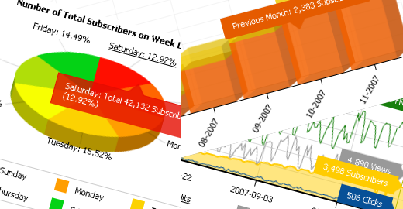
Web Data Overview (6/6) Privacy
Privacy may become an even bigger issue as time passes
Faceless customer analysis
An arbitrary ID number can be matched
It is useful to find the pattern, not the behavior of any specific customer
Behavioral Pattern
Notes:
Privacy는 내용이 방대하여 이 책에서 다룰 수 있는 내용은 아니다. 하지만 간단한 하나의 option에 대해서 살펴본다.
사람을 익명의 id로 매핑을 함으로써 privacy 문제를 일정 부분 해결해 줄 수 있다는 것
몇몇 분류의 행동 pattern을 찾는 데 사용된다.

Slide 33
Outline
What is Big Data and Why Does It Matter?
What Is Big Data?
How Is Big Data Different and More of the Same?
Risks of Big Data
The Structure of Big Data
Most Big Data Doesn’t Matter
Mixing Big Data with Traditional Data
Today’s Big Data Is Not Tomorrow’s Big Data
Web Data: The Original Big Data
Web Data Overview
What Web Data Reveals
Web Data in Action

Slide 34

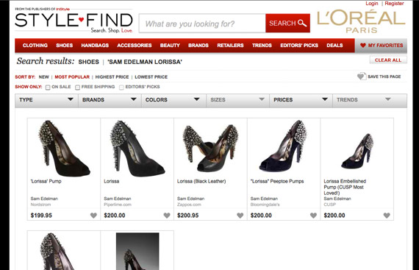
What Web Data Reveals (1/7) Shopping Behaviors
How customers come to a site to begin shopping
What search engine do they use?
What specific search terms are entered?
Do they use a bookmark they created previously?
→ Associated with higher sales rates
Search keywords

Slide 35
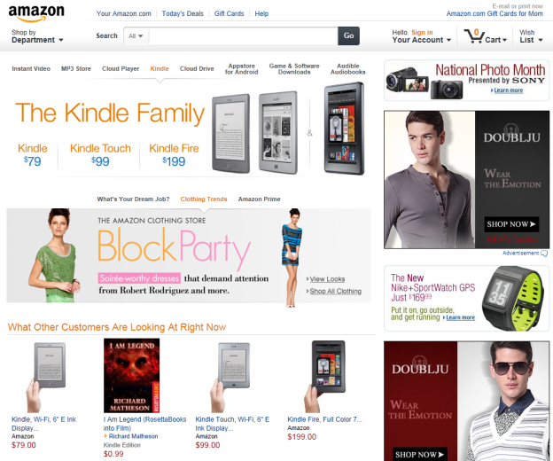
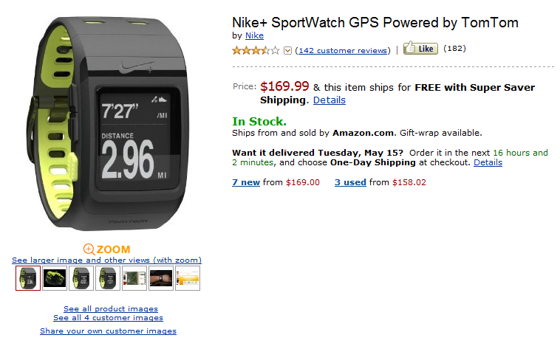
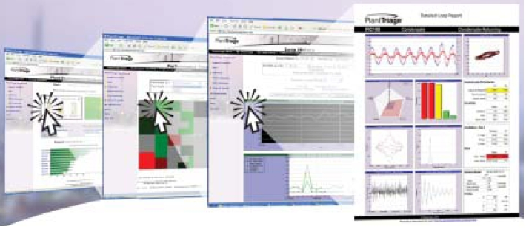
What Web Data Reveals (2/7) Shopping Behaviors (cont.)
Start to examine all the products they explore
Who looked at a product landing page?
Who drilled down further?
Who looked at detailed product specifications?
Who looked at shipping information?
Notes:
Landing page: 한 사이트에서 가장 처음 보이는 페이지

Slide 36
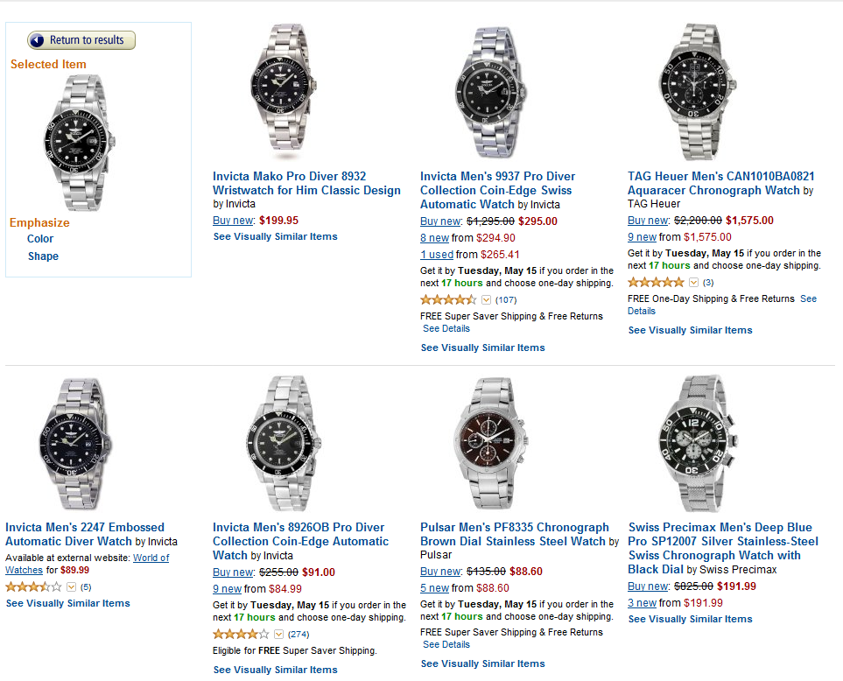
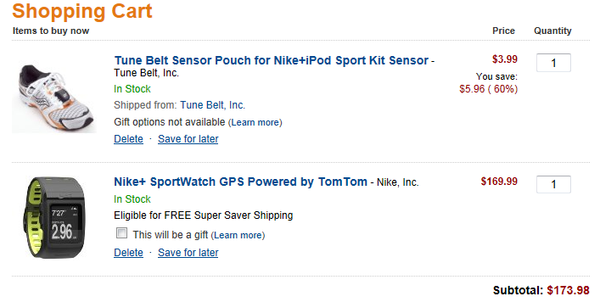
What Web Data Reveals (3/7) Shopping Behaviors (cont.)
Start to examine all the products they explore
Who took advantage of any other information?
Which products were added/later removed to a wish list or basket?
Notes:
사이트에서 제공하는 다른 information은 여러 가지가 있을 수 있다.
예를 들어 amazon에서는 어떤 물건을 검색하면 그 선택한 물건과 색 혹은 모양이 비슷한 상품을 검색할 수 있다.
또 다른 예로 여러 상품들을 동시에 비교해서 볼 수 있는 기능을 들 수 있다.

Slide 37
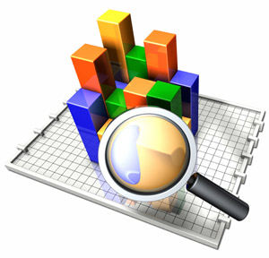
What Web Data Reveals (4/7) Research Behaviors
Understanding how customers utilize the research content can lead to tremendous insights into
How to interact with each individual customer
How different aspects of the site do or do not add value
Notes:
그들 나름대로의 research content를 이해함으로써 고객들이 중요하게 생각하는 것이 무엇인지를 파악한다는 것이다.
여기서 research content라는 것은 고객이 물건을 사기 위해 조사하는 모든 행동내용을 의미한다.

Slide 38
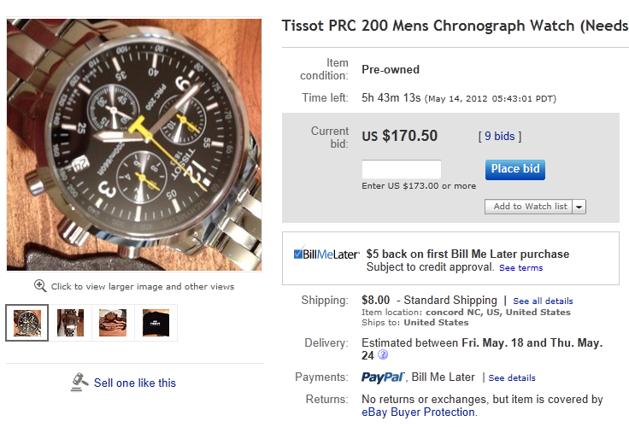

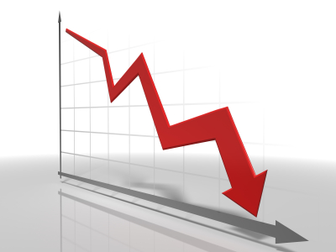
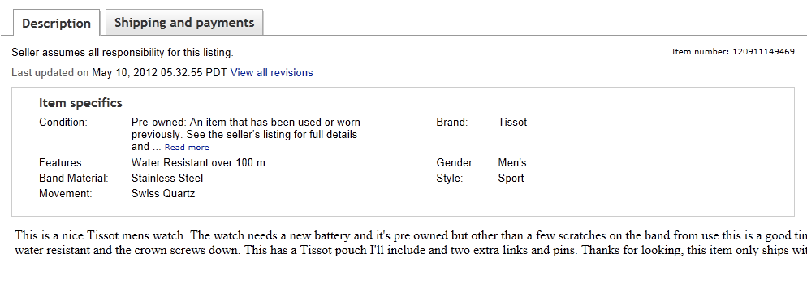
What Web Data Reveals (5/7) Research Behaviors - An Example
An organization may see an unusual number of customers dropping a specific product
Detailed specification
Notes:
고객들이 어떤 상품의 detail한 specification page를 보고 난 이후에 다른 상품에 비하여 판매율이 많이 저조하다면,
그 detailed specification page에는 뭔가 clear하지 않고 accurate하지 않은 정보를 담고 있을 가능성이 크다. 따라서 description을 update 한다면
판매율은 점차 높아질 수 있다.

Slide 39
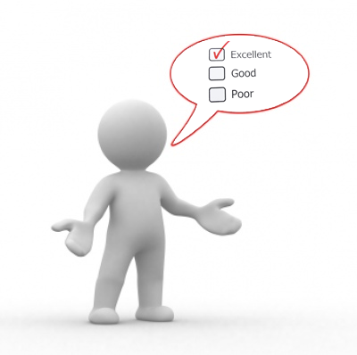

What Web Data Reveals (6/7) Feedback Behaviors
Some of the best information is
Detailed feedback on products and services
By using text mining, we can understand
Tone
Intent
Topic

Slide 40

What Web Data Reveals (7/7) Feedback Behaviors - Examples
Some customers post reviews on a regular basis
It is smart to give special incentives to keep the good words coming
By parsing the questions and comments via online help
It is possible to get a feel for what each specific customer is asking about
Customers in general
Each specific customer
Notes:
이 외에도 facebook이나 twitter를 고려해 볼 수 있다. Social media를 통한 feedback의 내용과 comment에 대하여 사람들의 “like”와 “dislike”를 파악함으로써
어떤 고객들이 어떤 상품에 어떻게 생각하는지에 대한 부분을 보다 잘 파악할 수 있다.

Slide 41
Outline
What is Big Data and Why Does It Matter?
What Is Big Data?
How Is Big Data Different and More of the Same?
Risks of Big Data
The Structure of Big Data
Most Big Data Doesn’t Matter
Mixing Big Data with Traditional Data
Today’s Big Data Is Not Tomorrow’s Big Data
Web Data: The Original Big Data
Web Data Overview
What Web Data Reveals
Web Data in Action

Slide 42

Web Data in Action (1/8) The Next Best Offer
A common marketing analysis is to predict what the next best offer is for each customer
To maximize the chances of success
Having web behavior data can be very useful

Slide 43
Web Data in Action (2/8) The Next Best Offer - An Example
At a bank, information about Mr. Smith
He has four accounts: checking, savings, credit card, and a car loan
He makes five deposits and 25 withdrawals per month
He never visits a branch in person
He has a total of $50,000 in assets deposited
He owes a total of $15,000 between his credit card and car loan
What is the best offer to place in an e-mail to Mr. Smith?
A lower credit card interest rate
An offer of a CD for his sizable cash holdings
But, how about offering a mortgage?
Notes:
CD나 cash holding은 경제학쪽 용어로 내용에 대한 것은 생략한다.

Slide 44
Web Data in Action (3/8) The Next Best Offer - An Example (cont.)
We have nothing that says it is remotely relevant
If Mr. Smith’s web behavior is examined and we got additional information
He browsed mortgage rates five times in past month
He viewed information about homeowners’ insurance
He viewed information about flood insurance
He explored home load options (i.e., fixed versus variable, 15- versus 30-year) twice in the past month
It’s pretty easy to decide what to discuss next
with Mr. Smith

Slide 45

Web Data in Action (4/8) Attrition Modeling
In the telecommunications industry,
Companies have invested massive amounts of time and effort for “churn” models
It is critical to understand patterns of customer usage and profitability
Notes:
Churn model: 가입 해지를 할 위험성이 높은 고객을 따로 표시하여, 그런 일이 발생하기 전에 사전대책을 강구하여 조치를 취하게 함을 목표로 한다.
* Churn
<네이버 지식사전에서 발췌>
통신회사 마케팅에서 쓰이는 용어로 단기간 동안 요금 등의 이유로 사업자를 자주 바꾸는 고객. Churn의 사전적 의미는 ‘군중이 우왕좌왕하다’이다. 신규가입 서비스를 제공하는 이동전화사업자들에게 심각한 문제로 대두되고 있는데 실제로 미국의 경우 이동전화사업에서 Churn의 비율은 25%에 달해 Churn Rate를 낮추는 일이 통신사업자의 중요한 과제가 되고 있다. 또한, 국내 이동 통신업계의 사업자간의 경쟁에서도 중요한 사안으로 떠오르고 있다.

Slide 46

Web Data in Action (5/8) Attrition modeling: an example
Mrs. Smith
A customer of telecom Provider 101
How do I cancel my Provider 101 contract?
Provider 101’s cancellation policies page
Knowing these actions are very important for a churn model!!
By capturing Mrs. Smith’s actions on the web,
Provider 101 is able to move more quickly to avert losing Mrs. Smith

Slide 47
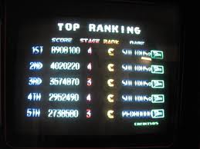
Web Data in Action (6/8) Response Modeling
It is similar to attrition modeling
The goal is predicting a negative behavior rather than a positive behavior (purchase or response)
In response model, all customers are scored and ranked
In theory, every customer has a unique score
In practice, a small number of variables define most models
Many customers end up with identical or nearly identical scores
Web data can help increase differentiation among customers

Slide 48
Web Data in Action (7/8) Response Modeling - An Example
4 customers scored by a response model
Has the exact same score due to having the same value: 0.62
Using web data, the scores are changed drastically
Last purchase was within 90 days
Six purchases in the past year
Spent $200 to $300 in total
Homeowner with estimated household income of $100,000 to $150,000
Member of the loyalty program
Has purchased the featured product category in the past year
Customer 1 has never browsed your site : 0.62 → 0.54
Customer 2 viewed the product category featured in the offer within the past month: 0.62 → 0.67
Customer 3 viewed the specific product featured in the offer within the past month: 0.62 → 0.78
Customer 4 browsed the specific product featured 3 times last week, added it to a basket once, abandoned the basket, then viewed the product again later: 0.62 → 0.86
Notes:
점수 높은 사람을 찾은 후에는? Organization에 따라 활용법은 다양할 수 있다.
제일 구매하지 않을 것 같은 사람을 구매하게 만들어야 할지,
제일 구매할 것 같은 사람이 확실하게 구매하게 만들어야 할지 등의 노력은
그 organization의 방향에 따라 정해질 수 있다.

Slide 49




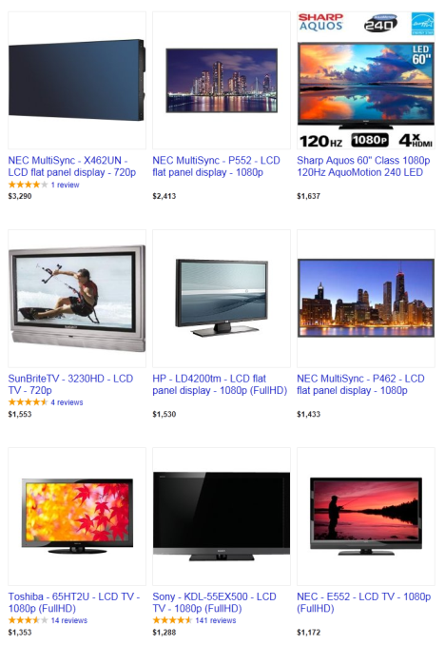
Web Data in Action (8/8) Customer Segmentation
Web data enables to segment customers based upon typical browsing patterns
Dreamer
Notes:
이러한 segmentation은 기존의 통계적 혹은 판매 중심의 segmentation schema와는 다른 고객에 대한 시각을 제공할 수 있다.
Dreamer라는 segment를 가정해보자. 이 segment는 순수하게 browsing behavior로부터 도출되었다.
그들은 basket에 물건을 넣었다 뺐다를 여러 번 반복한다. 이러한 반복동작을 하는 고객을 찾아내는 일은 그렇게 어려운 일이 아니다.
그럼 그들을 발견했다면 그들에게 혹은 organization에서 무엇을 할 수 있을까?
첫 번째로 그들이 basket에서 빼는 상품을 분석해본다. 그들이 포기하는 대부분의 이유는 기능은 마음에 들지만 가격이 비싸기 때문이다. 따라서 그들에게 가격은 더 저렴하면서
기능이 비슷한 다른 제품들을 제안할 수 있다.
두 번째는 organization에서 좀 더 정확한 분석이 가능해 진다는 것이다. Organization 입장에서 보면 basket에서 물건을 빼는 행위는 일종의 “failure”이다. 하지만 Dreamer segment의 경우
반복적으로 그러한 행위를 하게 된다. 이것은 정확한 failure의 통계를 내는데 방해요소가 된다. 따라서 Dreamer segment의 경우 반복적으로 빼는 행위를 하나의 행위로 적절히
묶을 수 있다. 이렇게 함으로써 좀 더 정확한 통계 분석을 할 수 있고 이로 인해 궁극적으로는 더 나은 판매 전략을 세울 수 있다.

Slide 50
Thank you

